Slide 1
Project Presentation of CO-OP Project at Industry (Module-2) (22CS421)
On
Synthetic Intelligence-Driven Simulation Framework for Autonomous Mobility in Mixed-Reality Vehicular Environments
Shivam Goyal Sameer Sahu
2210990822 2210990777
Supervised By
Dr.Darpan Anand & Dr. Gurpreet Singh
Department of Computer Science and Engineering,
Chitkara University, Punjab

Slide 2
Introduction
Autonomous Vehicle (AV) systems are rapidly maturing, and simulation has become an essential tool for evaluating and validating their safety before real-world deployment. Physical road testing alone is economically prohibitive — estimates indicate that approximately 275 billion miles of driving would be required to statistically prove human-level safety. Simulation offers a faster, safer, and more cost-effective alternative, provided it can faithfully reproduce the complexity of real driving environments.
Despite significant progress, most existing simulators rely on hand-crafted scenarios, simplified sensor noise models, and deterministic pedestrian behavior. As a result, they fail to expose AV controllers to the long tail of rare, high-risk corner cases that dominate real-world accident statistics. This work introduces the Synthetic Intelligence-Driven Simulation Framework (SIDSF) to address these limitations.

Slide 3
Problem Statement
Three core gaps motivate this research:
Static Libraries. Scenarios are often hand-picked by engineers and lack the statistical distribution of real-world corner cases, leading to over-fitting on a narrow operational design domain.
Sensor Realism. Simple Gaussian noise models fail to replicate complex physical effects such as rain scattering LiDAR returns, multipath reflections, or radar "ghost" detections under adverse weather.
Economic Constraints. Physical testing is costly, time-consuming, and dangerous. Approximately 275 billion miles of road testing would be needed to statistically prove human-level safety, which is infeasible in practice.

Slide 4
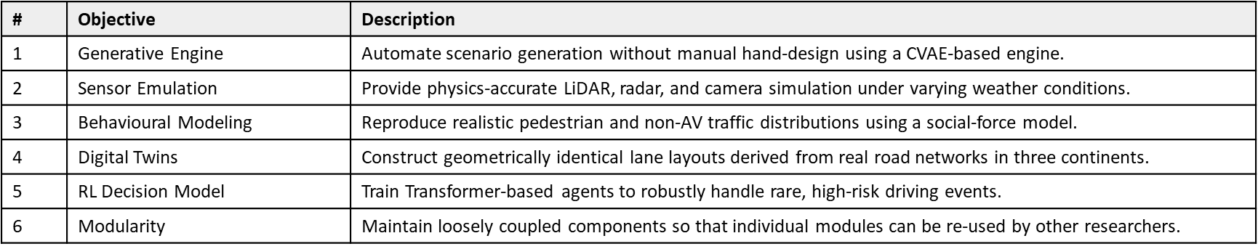
Objectives of the Study

Slide 5
System Architecture
The SIDSF Pipeline integrates five core modules into a closed-loop simulation system:
• GSE — Generative Scenario Engine (CVAE-based) for automatic scenario synthesis.
• MABE — Multi-Agent Behavior Engine implementing a Social Force model for pedestrians and traffic.
• Sensor Emulator — Physics-accurate ray-traced LiDAR, radar, and camera simulation.
• AVDC — Autonomous Vehicle Decision & Control module using a Transformer-based reinforcement learning policy.
• Closed-loop coupling — Outputs of each module feed back into the scenario engine to continually surface failure modes.

Slide 6
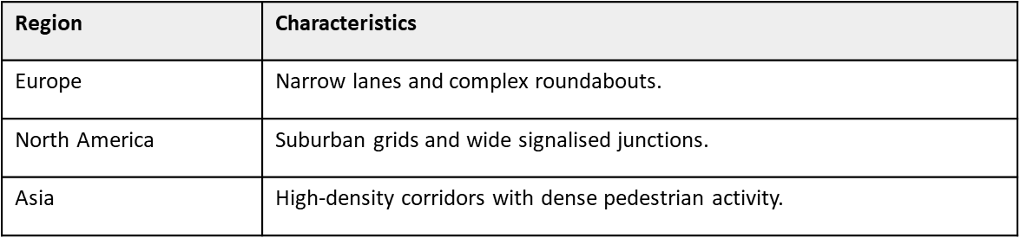
Dataset & Preprocessing
Digital twins were constructed by fusing LiDAR mapping with aerial photogrammetry for three major urban driving profiles, ensuring that the framework is evaluated under globally diverse road geometries and traffic densities.

Slide 7
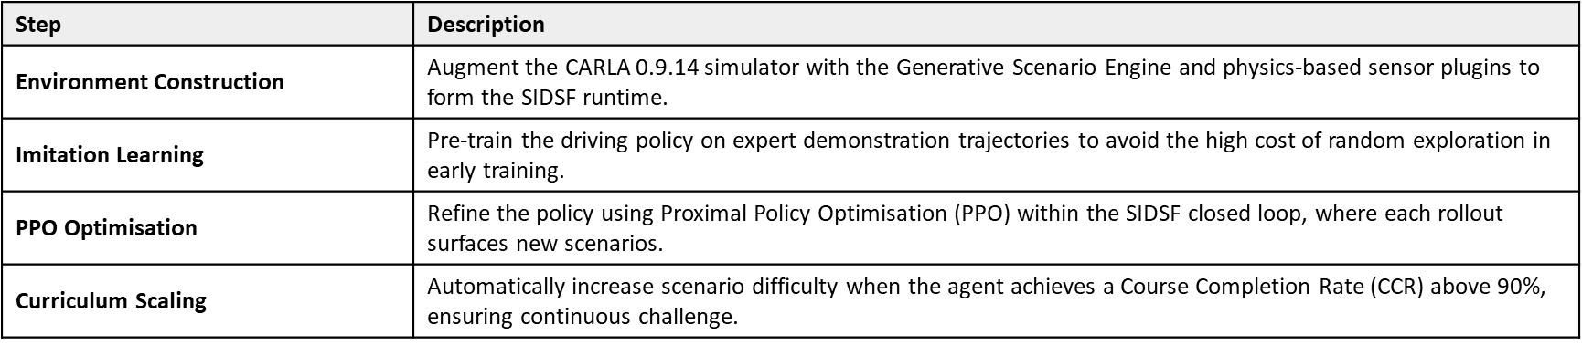
Methodology & Models

Slide 8
Tools & Evaluation Metrics
7.1 Technical Stack
• Simulator: CARLA 0.9.14 with custom SIDSF plugins.
7.2 Evaluation Metrics
• Safety: Collision Rate per Million Scenario-Kilometres.
• Perception: mean Average Precision (mAP) under adverse weather conditions.
• Comfort: Lateral and Longitudinal Jerk (m/s³).
• Efficiency: Required training hours to reach a target Route Completion Rate.
• AI Models: Conditional Variational Autoencoder (CVAE) for scenarios; Transformer for decision making.
• Training Algorithm: Proximal Policy Optimization (PPO).
• Languages & Libraries: Python, PyTorch, NumPy, OpenCV, ROS bridge for sensor I/O.

Slide 9
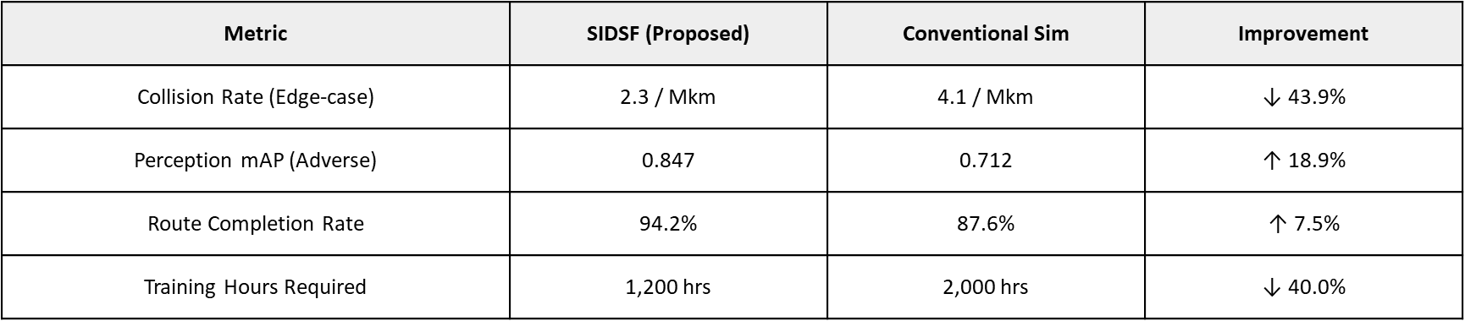
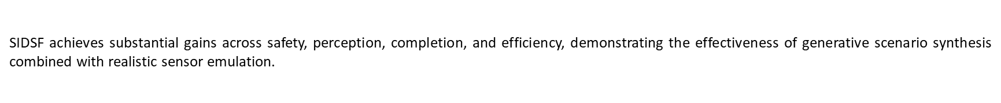
Results & Observations
SIDSF was benchmarked against a conventional simulation baseline across four key metrics.

Slide 10
Conclusion
The Synthetic Intelligence-Driven Simulation Framework (SIDSF) provides a principled and modular framework for evaluating autonomous vehicle technologies under realistic, naturalistically diverse conditions. By integrating generative scenario synthesis, physics-accurate sensor emulation, and a Transformer-based reinforcement learning controller within a closed-loop pipeline, SIDSF directly addresses the long-standing limitations of static scenario libraries and simplistic sensor models.
Experimental evaluation demonstrates a 43.9% reduction in edge-case collision rate, an 18.9% improvement in perception mAP under adverse weather, and a 40% reduction in required training hours compared to conventional simulation baselines. These results indicate that synthetic-intelligence-driven simulation is a viable path toward safer, more cost-effective validation of autonomous mobility systems.
Future work will focus on closing the residual sim-to-real gap in vehicle dynamics, integrating bidirectional telemetry from real fleets, and extending the framework toward formal safety verification.

Slide 11
Thank You

